Slide 1




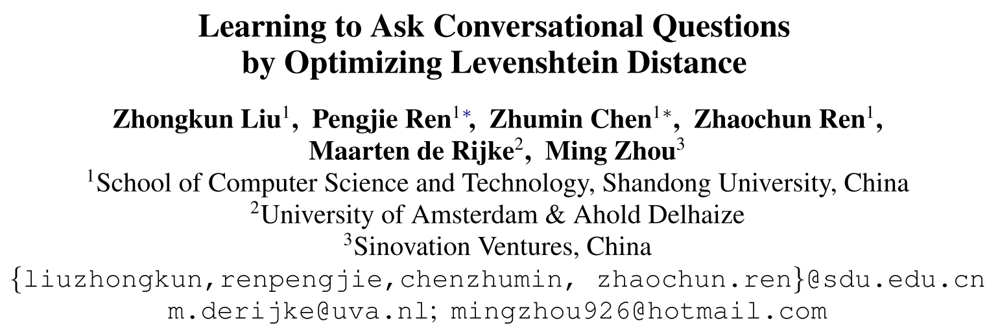





Chongqing University of Technology
ATAI
Advanced Technique of Artificial Intelligence
Chongqing University of Technology
ACL_2021
https://github.com/LZKSKY/CaSE_RISE
Hongyang Song

Slide 2
Outline
Motivation
Approach
Experiments
Conclusion

Slide 3
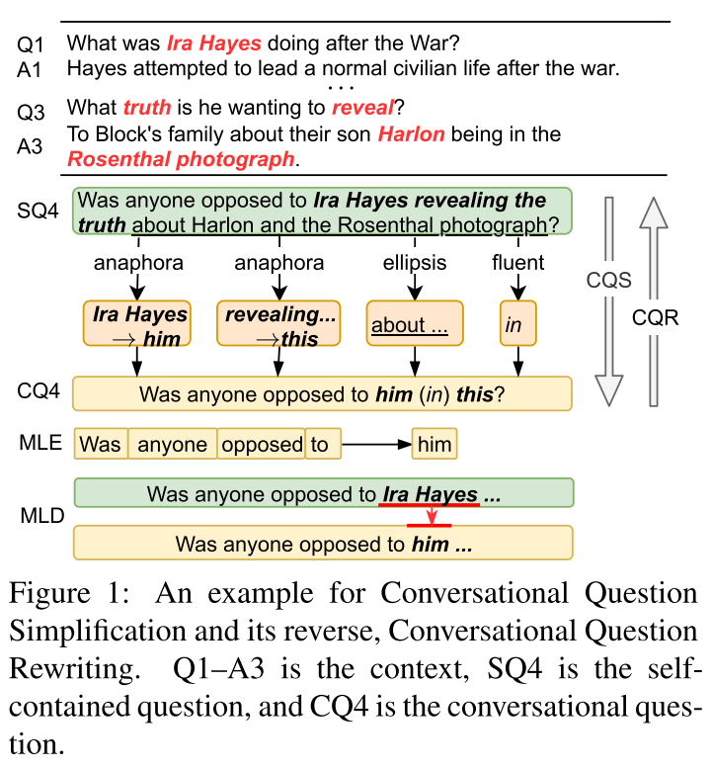
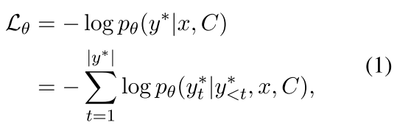

Motivation
Q1: 艾拉·海耶斯战后做了什么
A1: 海斯试图在战后过正常的平民生活
Q2: 他到底想揭露什么真相
A2: 告诉布洛克一家他们的儿子哈伦出现在罗森塔尔的照片里
SQ4: 有人反对艾拉·海耶斯揭露哈伦和罗森塔尔照片的真相吗
anaphora: 指代 ellipsis: 省略 fluent: 流利
CQ4: 这件事有人反对他吗?
MLE: 最大似然估计
MLD: 最小化编辑次数

Slide 4
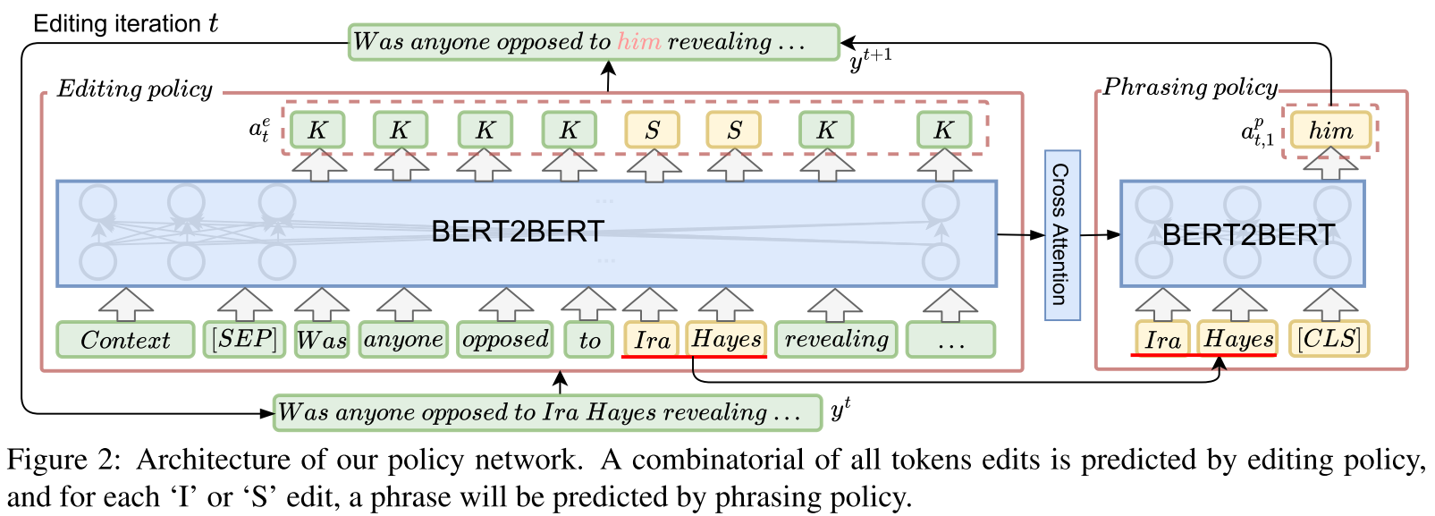
Approach
Action: Keep, Delete, Insert, Substitute

Slide 5
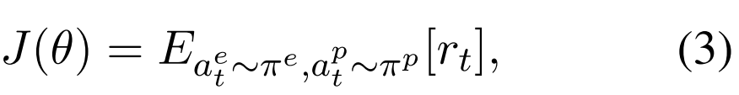


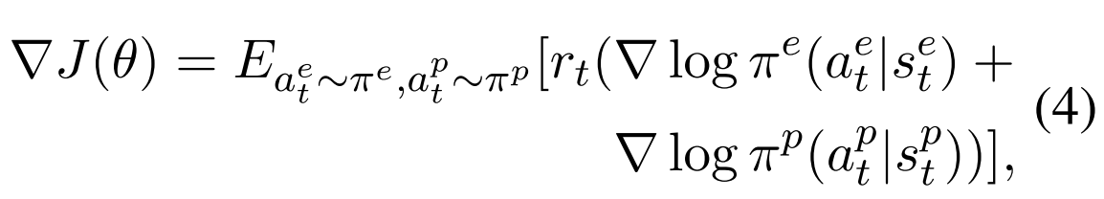



Approach
Action: Keep, Delete, Insert, Substitute
Editing Policy:
Phrasing policy:

Slide 6

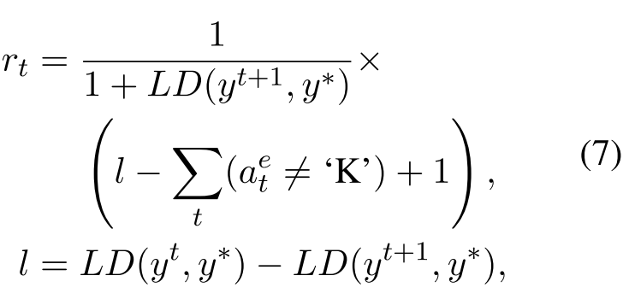

Approach
TACL_2020_Leveraging Pre-trained Checkpoints for Sequence Generation Tasks

Slide 7
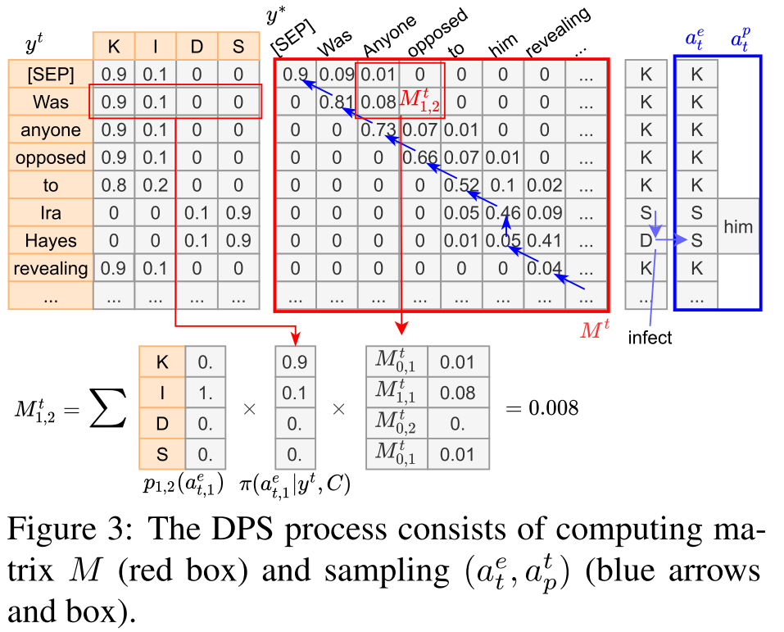
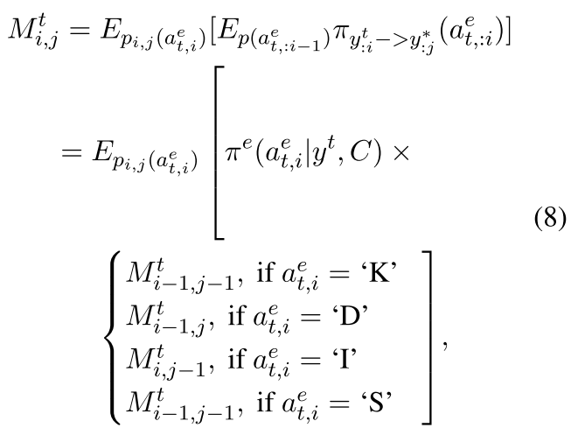
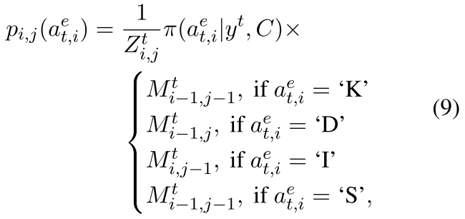
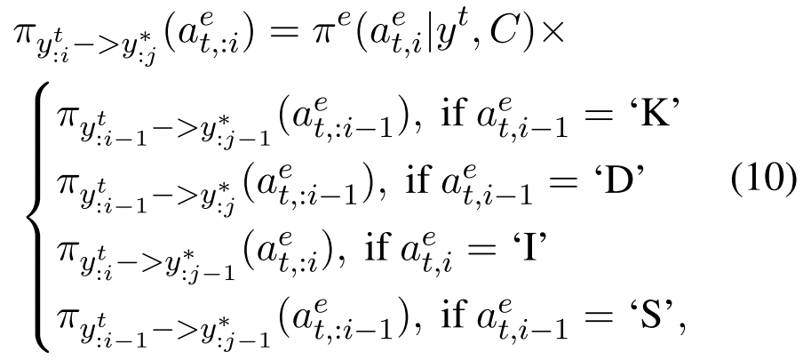
Approach
Training:

Slide 8
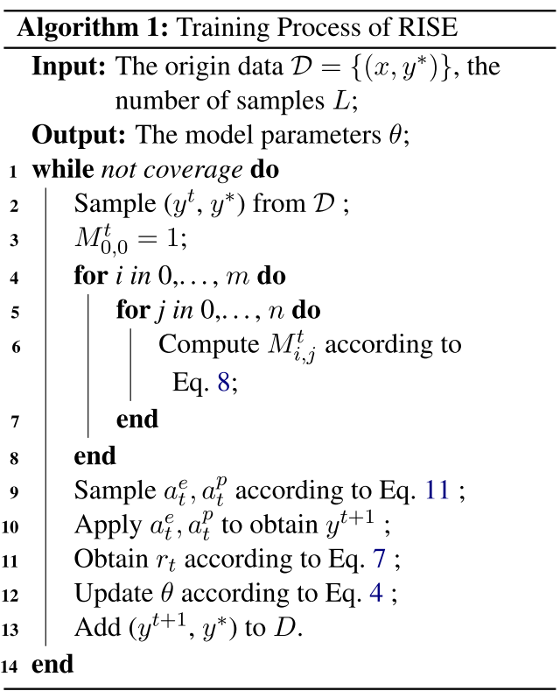
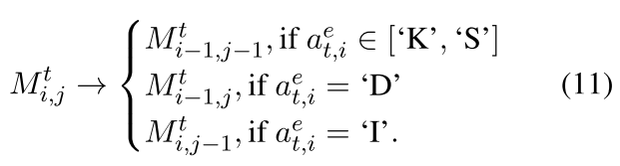
Approach

Slide 9
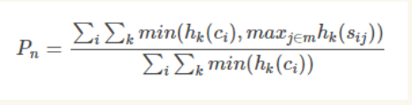
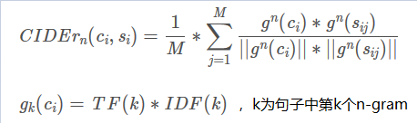

Experiments
CANARD
ACL_2019_Can you unpack that? Learning to rewrite questions-in-context
CAsT
Cast 2019: The conversational assistance track overview

Slide 10
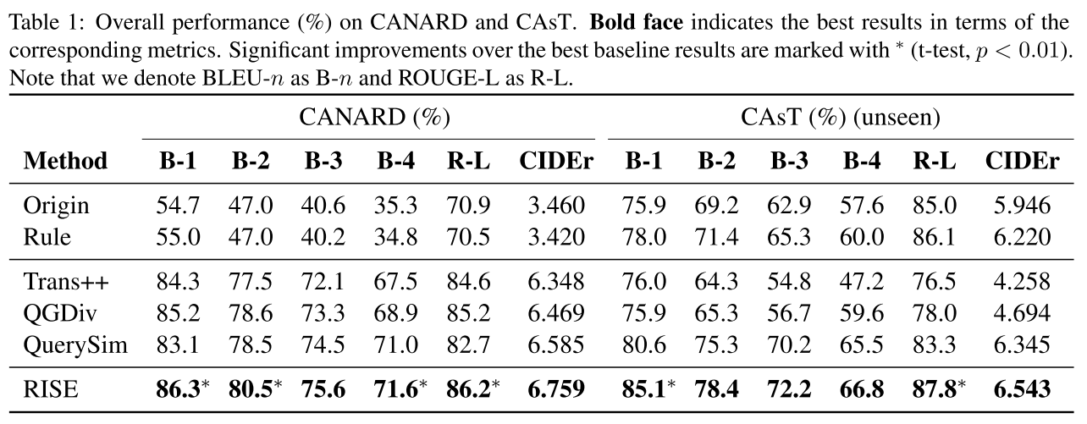
Experiments
BLEU-n 和 ROUGE-L衡量生成的问题和真实标签问题之间的词重叠
CIDEr 衡量的是重要信息缺失的程度

Slide 11
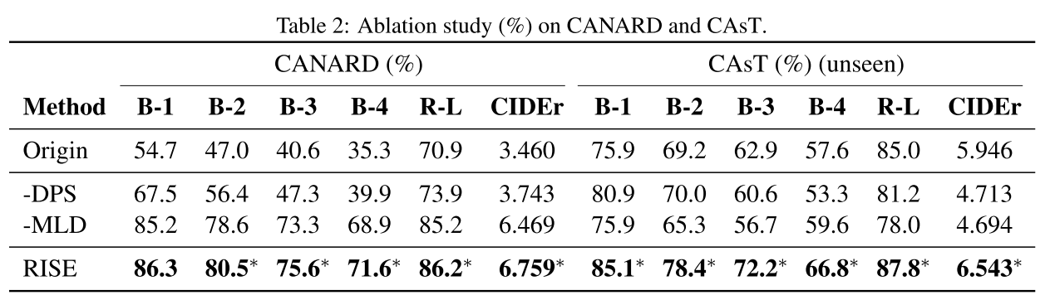
Experiments

Slide 12
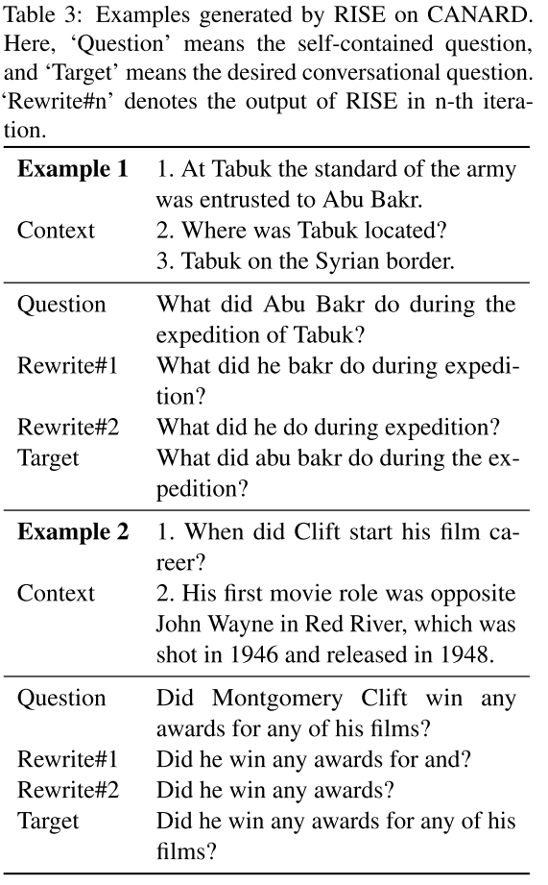
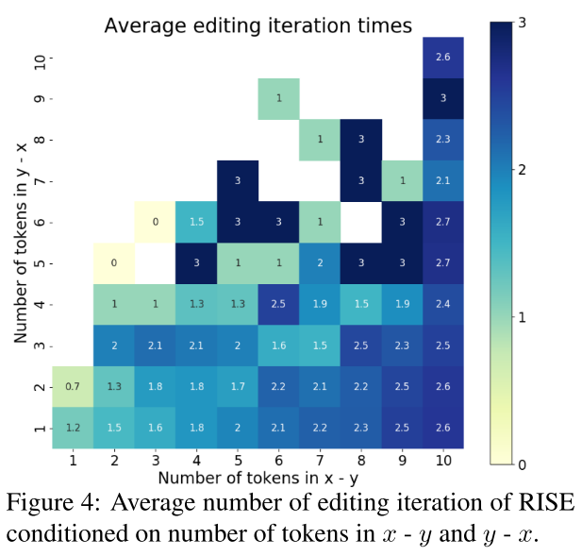
Experiments

Slide 13
Thanks

